Slide 1


Notes:
*Note to Barb*
This audio track will play through the entire presentation.

Slide 2
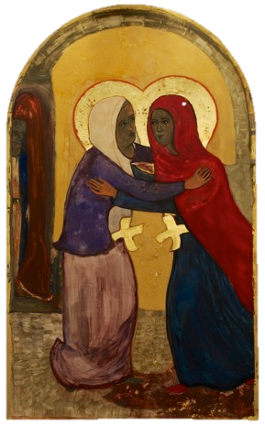
Notes:
Matthia Langone “The Visitation”

Slide 3
Let us pray…
  “Lord Jesus, just as you opened Elizabeth’s eyes in the presence of Mary, please open my eyes to those who also bear Christ. Help me to honour the potential of each person to be filled with the Holy Spirit.”
  (The Word Among Us, May 31, 2014)
Notes:
The Catholic Women’s League of Canada embracing our role on the world stage through prayer, trust and personal encounter.

Slide 4
“Each of us is capable of bearing Christ to the world.”
  While the meeting between Mary and Elizabeth was unique, there is something here we can all experience…each of us is capable of bearing Christ to the world. If our eyes were opened to the glory of this truth, we too would rejoice and be humbled in the presence of so holy a vessel as a sister or brother in Christ.

Slide 5
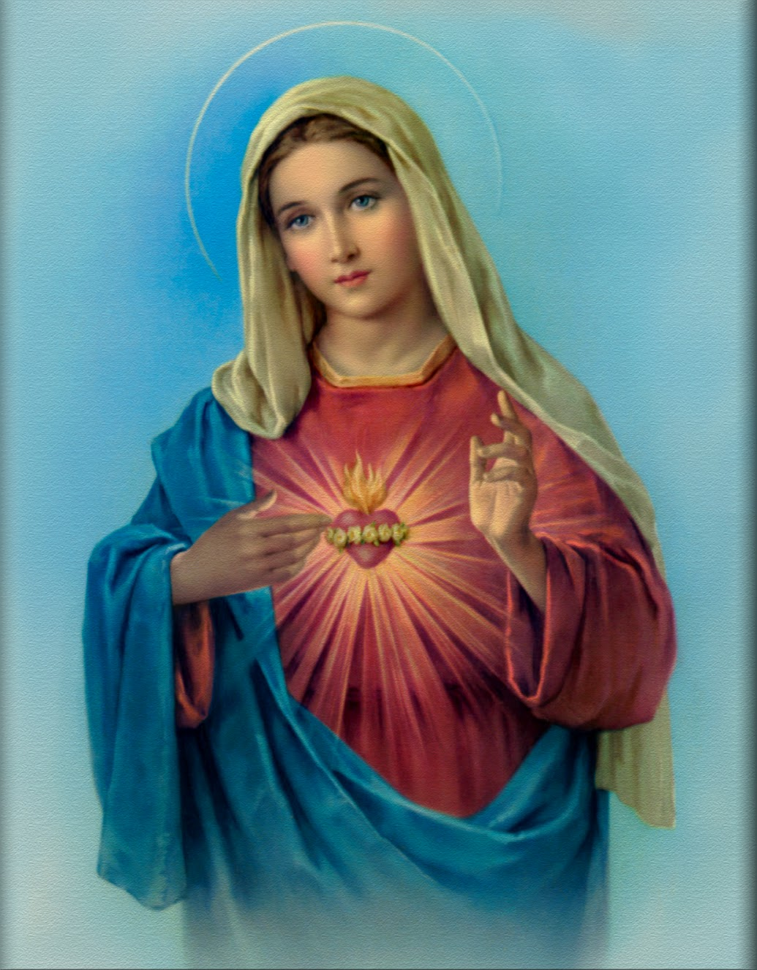
One Heart
Notes:
One Heart
filled with mercy compassion and holiness
that forgiven we can forgive others; personal conversion; give back to the Lord for all he has given to us).
encounters beginning with prayer – reaching another’s heart, touching the heart of God
the Church is strengthened and transformed when we nurture, develop and share our gifts.

Slide 6
One heart filled with…
Mercy
Compassion
Holiness

Slide 7
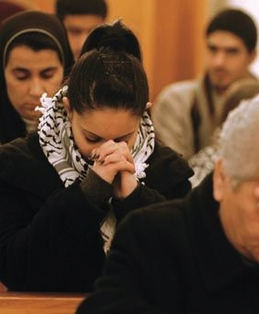
Reaching another’s heart
Touching the Heart of God
Personal encounter
begins with prayer
Notes:
encounters beginning with prayer – reaching another’s heart, touching the heart of God

Slide 8
“Let us be friends with one another, and kind – forgiving each other readily – as we are forgiven by God.”
(Ephesians 4:3)
Notes:
the Church is strengthened and transformed when we nurture, develop and share our gifts.

Slide 9
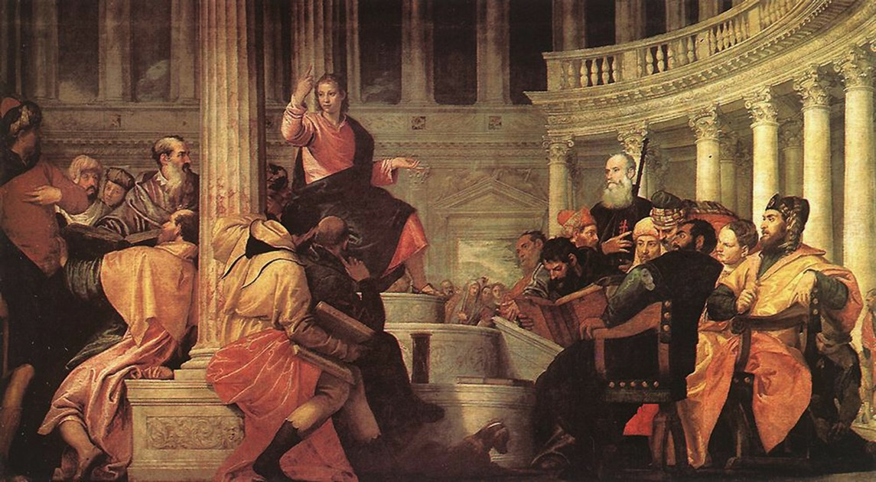
One Voice
Notes:
One Voice
united in harmony to speak the truth with courage and zeal
like the early Church that all are cared for; a voice for the voiceless; confident in the Holy Spirit
encounters of hearing first, then speaking, listening and doing whatever He tells us

Slide 10
  One Voice…
  United in harmony
  to speak the truth with
  courage & zeal

Slide 11

“I sought to hear the voice of God and climbed the highest mountain, but God declared: Go down again,
I dwell among the people.”
Anonymous
Notes:
encounters of hearing first, then speaking, listening and doing whatever He tells us

Slide 12

Let us be the voice to make a change for good and speak for those who cannot

Slide 13
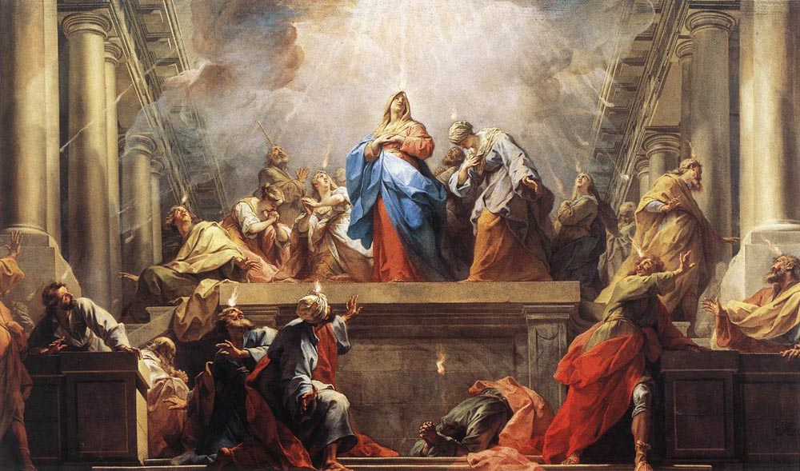
One Mission
Notes:
One Mission
witnessing to the Good News through personal encounter and joyful service
Like Mary, Star of the New Evangelization, always aware of our needs and the needs of others; ready to act when necessary... who who kept all things in her heart and pondered; this same Mary is the woman of prayer and work in Nazareth (EG288) who told them, “Do whatever He tells you.” (EG 288)
encounters that answer the call, the ‘yes’ the ‘Here I am Lord’ going forth
Making the ‘art of accompaniment’ (as per Francis) an integral part of going forward...(EG169) with a compassionate gaze.

Slide 14
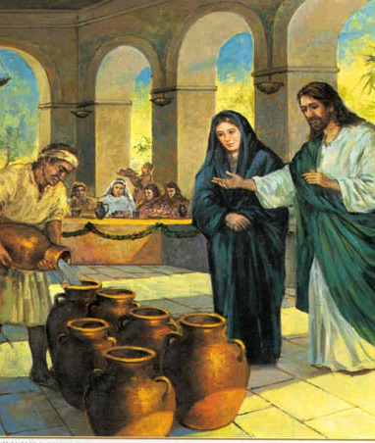
Like Mary, Star of the New Evangelization, always aware of our needs and the needs of others; ready to act when necessary... who kept all things in her heart and pondered; this same Mary is the woman of prayer and work in Nazareth who told them,
“Do whatever He tells you.”
(Evangelii Gaudium 288)

Slide 15
Just as John the Baptist leapt for joy in his mother’s womb when the presence of Christ was brought by Mary to Elizabeth that we too may bring the Holy Presence to all we encounter.
Matthia Langone, The Recognition, tempera & gold on board, 39.75” x 24”, 2013
Notes:
We ask for a holy courage to seek new paths. Just as John the Baptist, leapt for joy in his mother’s womb when the presence of Christ was brought by Mary to Elizabeth that we too may bring the Holy Presence to all we encounter.

Slide 16


We ask for a holy courage to seek new paths
We ask for…
holy courage
…to seek new paths

Slide 17

“Then I heard the voice of the Lord saying:
Who should I send?”
(Isaiah 6:8)

Slide 18

The Catholic Women’s League of Canada - called to holiness through service to the people of God.

Slide 19
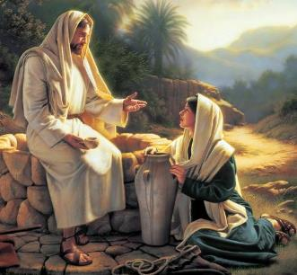
The Catholic Women’s League of Canada - embracing the call through prayer, trust, and personal encounter.

